Slide 1
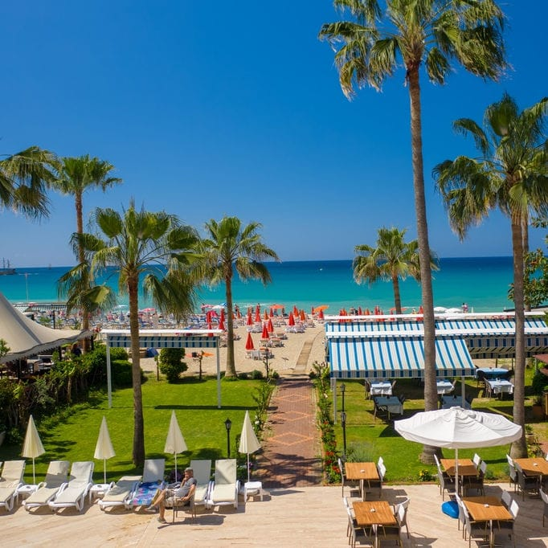
SUSTAINABILITY
MANUAL ELYSEE BEACH
HOTEL
SUSTAINABILITY MANUAL

Slide 2
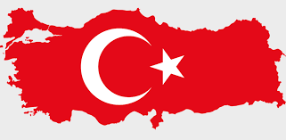
REPUBLIC OF TÜRKİYE
FOUNDING OF THE REPUBLIC OF TÜRKİYE
After the National War of Independence which began on May 19, 1919, the First Turkish Grand National Assembly (TGNA) convened on April 23, 1920, under the leadership of Mustafa Kemal Atatürk. With the adoption of the first constitution on January 20, 1921, "Sovereignty unconditionally belongs to the nation. The executive and legislative power is gathered in the TGNA on behalf of the Turkish nation." On April 23, 1921, the first anniversary of the opening of the TGNA was declared a national holiday with Law No. 112. The Republic was proclaimed on October 29, 1923. .

Slide 3
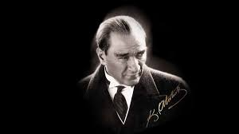
MUSTAFA KEMAL ATATÜRK (1881-193∞)
ATATÜRK, THE FOUNDER AND FIRST PRESIDENT OF THE REPUBLIC OF TÜRKİYE, was born in Salonica in 1881. His mother was Zübeyde Hanım, and his father was Ali Rıza Efendi. He attended Mahalle Mektebi, Şemsi Efendi Okulu, Salonica Civil Secondary School, Salonica Military Secondary School, Salonica Military High School, War College, and War Academy, respectively. In 1893, while studying at the Military Secondary School, his math teacher added "Kemal" to his name, and he became Mustafa Kemal. After the Ottoman Empire was defeated in World War I, the Armistice of Mudros was signed. Following this agreement, as the occupation of the homeland began, Mustafa Kemal landed in Samsun on May 19, 1919, and launched the national struggle. On April 23, 1920, with the opening of the TGNA, Mustafa Kemal was elected as the Speaker of the Assembly and the Head of the Government. After the victory in the Sakarya Battle, he was honored with the title of Gazi and the rank of Marshal. With the proclamation of the Republic on October 29, 1923, Mustafa Kemal became the first President of the Republic of Türkiye.

Slide 4
ELYSEE BEACH HOTEL OUR QUALITY AND SUSTAINABILITY POLICY
By prioritizing social, environmental, and cultural values, within the framework of local and international laws and standards, and by implementing the Integrated Management System that we have documented and continually develop by creating a corporate culture based on quality, food and water safety, occupational health and safety, information security, communicable disease management, and sustainable tourism, we commit to: COMPLIANCE WITH LAWS: Complying with current legal regulations, national and international standards, and all compliance obligations related to our activities. CONTINUOUS IMPROVEMENT AND ANALYSIS: Ensuring continuous improvement by prioritizing the satisfaction of all stakeholders in our activities, and by evaluating our internal and external issues, the needs and expectations of our interested parties, and analyzing potential risks and opportunities arising from these risks in advance. STAKEHOLDER FOCUS: Monitoring and measuring system performance and implementation effectiveness with a stakeholder focus by defining objectives, risks, opportunities, and threats, and creating channels for our employees, guests, the local community, and all our stakeholders to convey their needs, requests, suggestions, and complaints. EMPLOYEE PARTICIPATION: Providing the necessary training to increase the awareness and competence of our employees, whom we select from the local community as much as possible, and ensuring their participation, including their suggestions, in all our activities through encouragement, motivation, and effective communication. OCCUPATIONAL HEALTH AND SAFETY: To provide a safe and healthy working and living environment for our employees, guests, and all stakeholders: creating and effectively implementing an organization capable of intervening in emergency situations in the shortest time and most effectively by planning to prevent accidents and occupational diseases. FOOD AND WATER SAFETY: To provide a safe and healthy working and living environment for our employees, guests, and all stakeholders: creating and effectively implementing an organization capable of intervening in emergency situations in the shortest time and most effectively by planning to prevent all illnesses caused by food, water, and infections. INFORMATION SECURITY: Protecting the confidentiality, integrity, and accessibility of information, and ensuring the personal data security of our employees, guests, and stakeholders.

Slide 5
OUR QUALITY AND SUSTAINABILITY POLICY
ELYSEE BEACH HOTEL
PROTECTION OF CHILD AND WOMEN'S RIGHTS: In our facilities: providing opportunities for children to contribute to their development, freely express their thoughts and wishes, and feel free and comfortable under the supervision of their parents; opposing all actions that may leave mental and physical impacts and restrict the rights of all individuals, especially Children, Women, and Persons with Reduced Mobility, and fighting against such actions within the framework of laws by sharing this awareness with all our employees and stakeholders. BARRIER-FREE LIVING: Making necessary arrangements in our facilities for our employees and guests with reduced mobility to fully benefit from all opportunities and environments safely and peacefully, and to access them without hindrance. FAIR WORK AND GENDER EQUALITY: For the participation of women in the workforce: providing a working and living environment that protects the work/family life balance, prevents the restriction of rights, and observes the principle of equality without gender discrimination. PROTECTION OF THE ENVIRONMENT AND NATURE: When planning our investments and activities: taking into account their effects on protected sensitive areas, historical heritage, and the integrity of the natural and cultural environment; prioritizing the efficient and economical use of natural resources, and preferring plants, practices, and materials suitable for the region/local area/ecosystem in our landscaping work. Our philosophy of generating as much energy as we consume: reducing our carbon footprint in our use of energy and natural resources that cause climate change, planning and investing to reduce energy and natural resource consumption in our activities by using economical devices and methods appropriate to current conditions, and measuring and analyzing consumption. We will not keep banned/endangered species of animals and plants that threaten natural life within our facilities or activities, and in case of detection, the necessary notifications will be made directly to the legal authorities.

Slide 6
OUR QUALITY AND SUSTAINABILITY POLICY
ELYSEE BEACH HOTEL
PROTECTION OF COMMUNITY AND CULTURAL VALUES: Contributing to the protection, development, and promotion of historical, archaeological, cultural, and spiritual local/regional foods, sites, and traditions in our country and region. PURCHASING: When purchasing all products and materials we supply, evaluating their nature and quality with users, analyzing their suitability within our activities, and auditing the individuals/companies we supply from: ensuring that their harmful effects on the environment, natural life, ecosystem, and human and living health are kept at the lowest possible level, sourcing from local producers or fair suppliers more frequently within the legal framework, with less packaging and a lower carbon footprint. ZERO WASTE: In our facilities: ensuring the effective separation of generated waste by informing and raising awareness for the correct and in-place separation of waste within the scope of the "Zero Waste" project, preferring recyclable materials, ensuring the disposal of non-recyclable materials by authorized institutions, and reducing the amount of waste by keeping the use of single-use materials at the lowest possible level. * We commit to this.

Slide 7
GES PROJECT
Elysee Hotels group has 2 Solar Power Plants (GES) installed in Eğirdir Barla district of Isparta: GES A 400(KWH) and GES B 599(KWH). We are committed to sustainability by generating the electricity consumed at our hotels from our own solar power plant investment.

Slide 8
HARİTA ve GÜZARGAHLAR
📍 Gezi Noktası | 🚌 Otobüs Hattı | 🚏 Durak | 🚶‍♂️ Yürüyüş Mesafesi | 📝 Açıklama | 📏 Mesafe
Alanya Kalesi | 4 (Ring) | Hisariçi – Kale | 1 dk | Zirveye direkt ulaşım. Alternatif: 1/50 + Teleferik | 4,3 km
Kleopatra Plajı | 1, 50 | Kleopatra | Çok kısa | Halk plajı. Bisiklet yolu ve yürüyüş alanı mevcut | 1,1 km
Damlataş / Teleferik | 1, 50 | Damlataş Kültür Merkezi | 100–300 m | Teleferik, Mağara ve Müze aynı bölgede | 700 m
Atatürk Cd. / Şehir Merkezi | 1, 40 | Merkez Duraklar | Yürüyüş dostu | Alışveriş, kültür ve yemek noktaları | 900 m
Dimçayı | 2B, 3, 20, 40 | Dimçayı Girişi | Yakın | Doğa içinde piknik ve şelale keyfi | 16 km
Kestel / Mahmutlar | 2, 20, 40 | Sahil boyunca | Çeşitli | Plajlar, kafe ve yürüyüş yolu | 10 km
Syedra Antik Kenti | - | - | - | Otogardan minibüs veya tur acentesiyle | 23 km
Sapadere Kanyonu | - | - | - | Otogardan minibüs veya özel ulaşım | 26 km
Manavgat Şelalesi | - | - | - | Tur firmaları ile tam gün tur | 61 km
Side Antik Kent | - | - | - | Otogardan otobüs ya da tur ile | 64 km
Aspendos Tiyatrosu | - | - | - | Antalya yönüne minibüs/tur | 92 km
Antalya Kaleiçi | - | - | - | Şehirlerarası otobüs ya da özel araç | 123 km

Slide 9
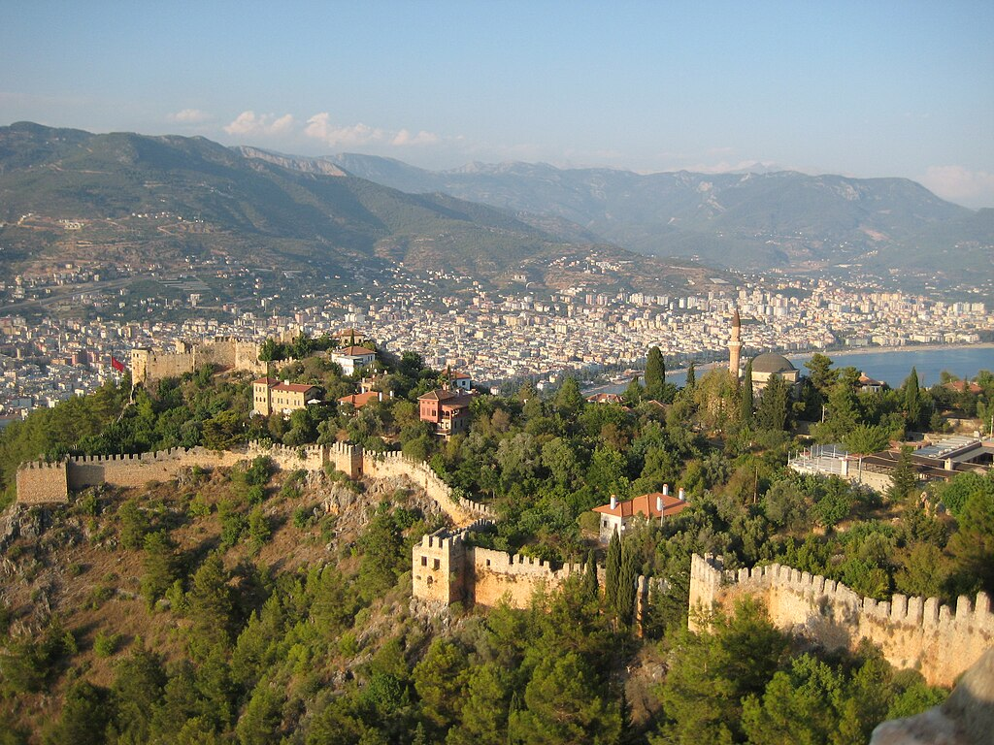
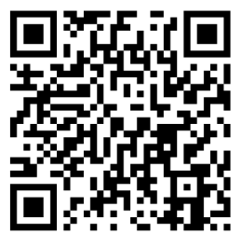
ALANYA CASTLE
Alanya Castle is a castle that is one of the symbols of Alanya district of Antalya. It is located on a peninsula that rises approximately 250 meters from the sea. The total length of its walls is 6.5 kilometers. The castle was built during the Hellenistic period in the Alanya settlement, which was called Candeleri in ancient times. The historical texture of the castle today is a 13th-century Seljuk work, and its history dates back to the Hellenistic period. The castle was built by the Seljuk Sultan Alaeddin Keykubad I, who conquered the city and rebuilt it in 1221. There are a total of 83 towers and 140 bastions in the castle. Approximately 1200 cisterns were built within the walls during the Middle Ages to meet the water needs of the city. Some of the cisterns are still in use. The walls were built systematically to end at the Kızılkule (Red Tower) after passing Ehmedek, İçkale (Inner Castle), Adam Atacağı, Cilvarda headland, Arap Evliyası, and Esat Bastion, and going through Tophane (Armory) and Tersane (Shipyard).

Slide 10
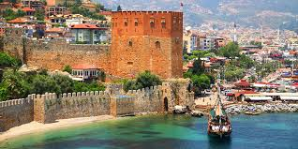
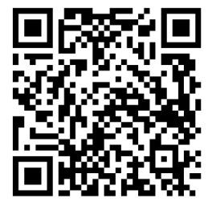
ALANYA KIZILKULE (RED TOWER)
Kızıl Kule is a historical tower located in the city of Alanya, Türkiye. The structure is considered the symbol of the city and is used on the city's flag. The construction of the building began in the early sultanate of the Anatolian Seljuk Sultan Alaeddin Keykubad I and was completed in 1226. The Sultan brought the master architect Ebu Ali Reha from Aleppo, Syria, to Alanya to complete the building. The octagonal red brick tower protects the Shipyard dating from 1221. Its name comes from the redder bricks used in its construction. It continues to be one of the finest examples of medieval military architecture and is the best-preserved Seljuk building in the city.

Slide 11
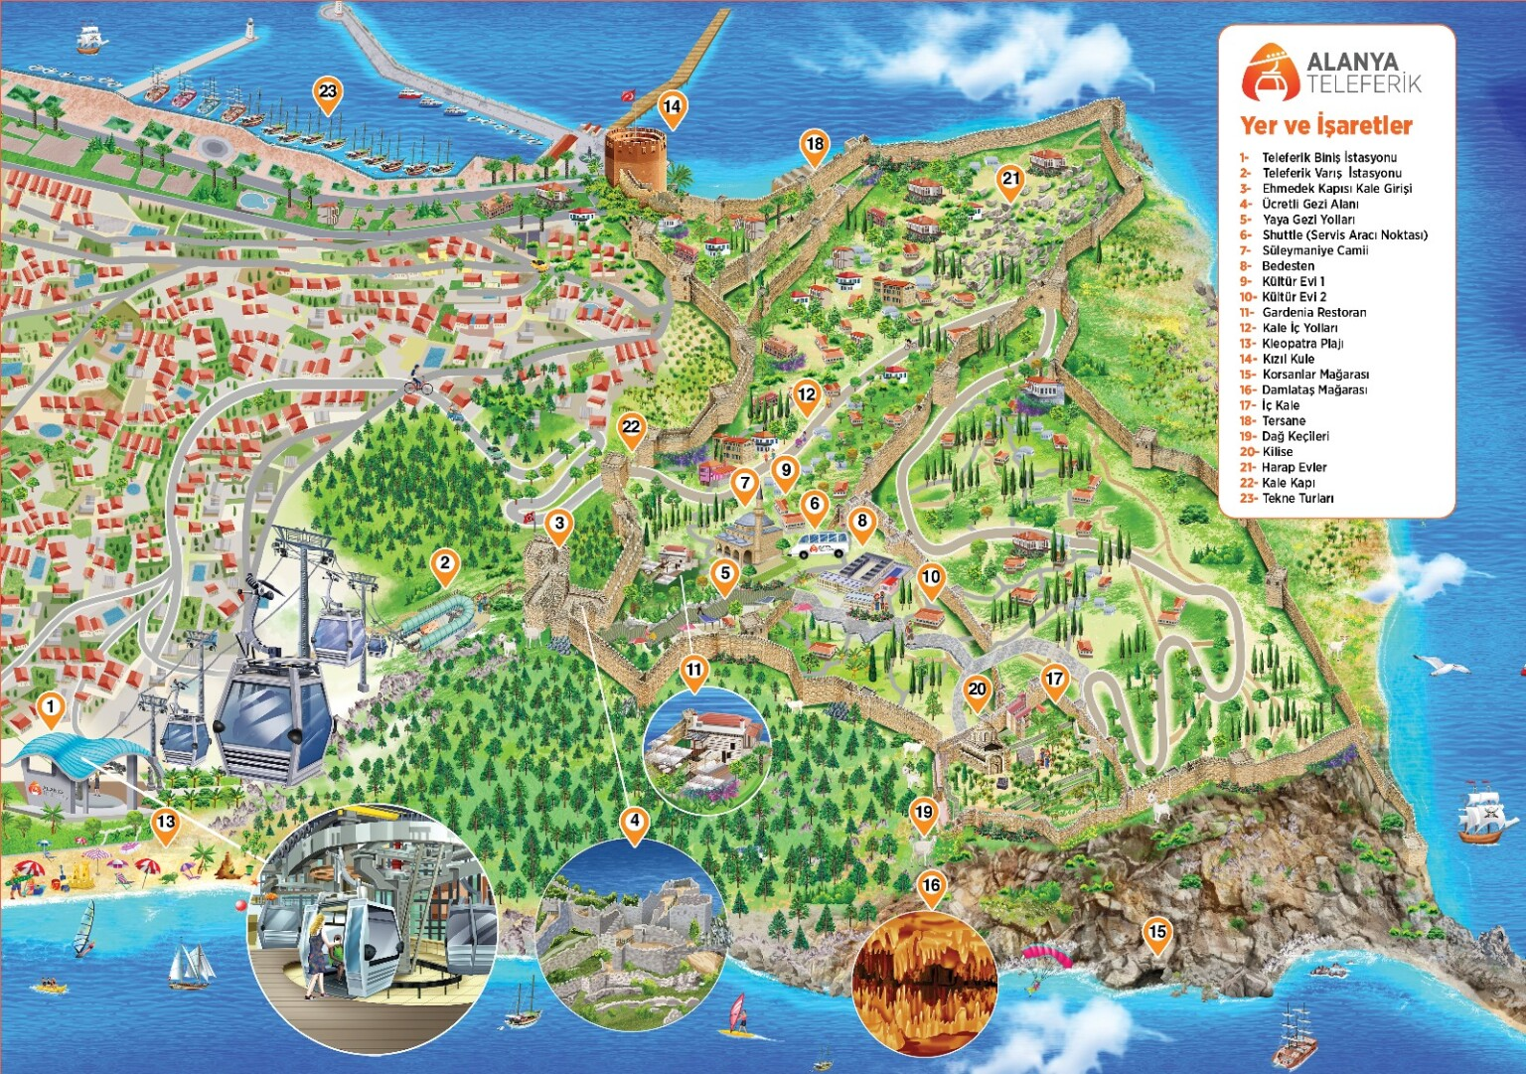
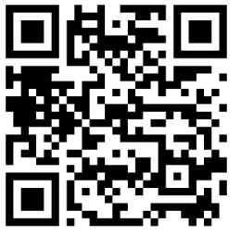
ALANYA CABLE CAR
Alanya Cable Car offers "ecology-sensitive transportation" with its technology gracefully placed within nature. Great care is taken at every stage of its construction and operation to protect the environment and consume natural resources economically. It incorporates all the advantages of ecological transportation vehicles. The Alanya Cable Car system is designed to operate in all weather conditions and can continue to operate uninterruptedly in conditions such as rain, wind, and high temperatures.

Slide 12
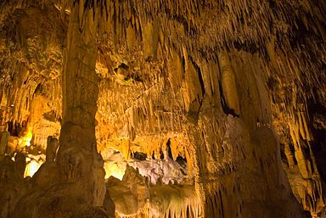
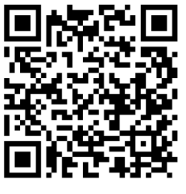
DAMLATAŞ CAVE
Damlataş Cave is a cave on the coast in the Alanya district of Antalya. It is located 3 km away from Alanya city center and on the western shore of the historical Alanya Castle. The cave is named Damlataş (Dripping Stone) due to the water drops that continue to drip from the stalactites. It was discovered in 1948 as a result of a dynamite blast in its current location, which was identified as a quarry to be used in the port construction. This cave, adorned with thousands of beautiful stalactites and stalagmites, was immediately taken under protection, research on the cave was started, and it was opened to tourism. Damlataş Cave is the first cave in Türkiye to be opened to tourism.

Slide 13
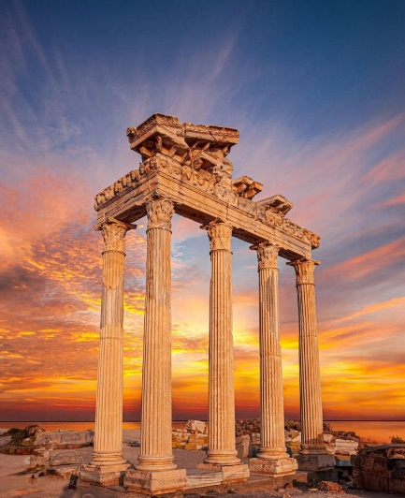
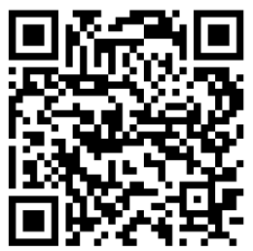
SIDE ANCIENT CITY
SIDE ANCIENT CITY
The ancient city of Side is among the most important settlements in history, founded in the 7th century BC. This historical city, which belongs to the Pamphylia region, first entered the Lydian Kingdom and remained under this rule for many years. Later, the ancient city of Side passed to the Persian Kingdom, and with the request of Alexander the Great for the region, it passed to the King of Macedonia. .

Slide 14
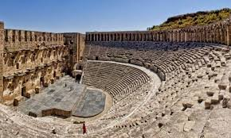
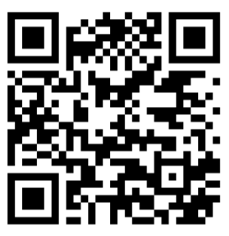
ASPENDOS ANCIENT THEATRE
Aspendos is an ancient city famous for its ancient theater, located in Belkıs village in the Serik district of Antalya province. Aspendos is known for hosting the Aspendos Roman Theatre, the best-preserved theater of antiquity. The most important structure of Aspendos is its theater. It is an open-air theater that has been preserved in the best way among ancient theaters. This theater is the oldest and most intact example in Anatolia that has survived to the present day with its stage. Its architect is Zenon, the son of Theodorus of Aspendos.

Slide 15
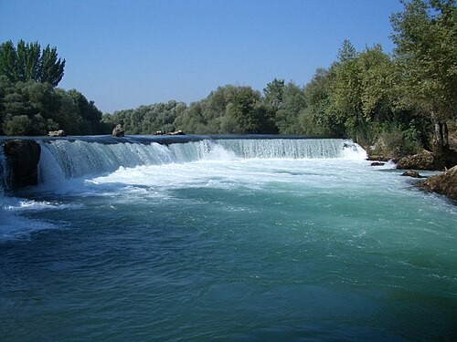
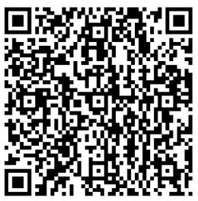
MANAVGAT WATERFALL
Manavgat Waterfall is a waterfall located on the Manavgat River in the Manavgat district of Antalya. Although it falls from a small height, it flows with a high discharge over a wide area. Around the Manavgat Waterfall, there are picnic areas available for the public and properties operating as live fish restaurants as part of tourist facilities. With the Presidential decree dated March 15, 2023, the area shown was registered and declared as a Definitely Protected Sensitive Area as a result of the Evaluation of the Conservation Status of the Potential Natural Site Area.

Slide 16

HOW TO GET THERE?
ALANYA CASTLE
Take the public buses in front of our hotel and get off in Alanya city center. Access to the Castle can be provided by buses going to the Castle or by the Cable Car from Damlataş.
ALANYA PIER - KIZILKULE (RED TOWER)
It can be reached within walking distance from the front of our hotel.
MANAVGAT – SIDE
Access to Manavgat and Side center can be provided in 1.5 hours by taking the Antalya buses that pass on the main street in front of our hotel. ANTALYA Take the buses that pass on the main street in front of our hotel to the bus station. Antalya buses can reach Antalya center in 2.5 hours.
ANTALYA - GAZİPAŞA AIRPORT
Our hotel guests can reach Antalya airport in 2 hours with their own agency's transfer vehicles. Our hotel guests can reach Gazipaşa airport in 1 hour with their own agency's transfer vehicles.
ALANYUM SHOPPING CENTER
It can be reached by taking the public bus that goes to Alanyum shopping center from the bus stop in front of our hotel. * In settlements, public transportation is provided with Controlled City Minibuses for a fee or with city cards for Municipal Buses.* Our guests can also benefit from taxi services at the taxi stands located near our hotel if they wish.

Slide 17
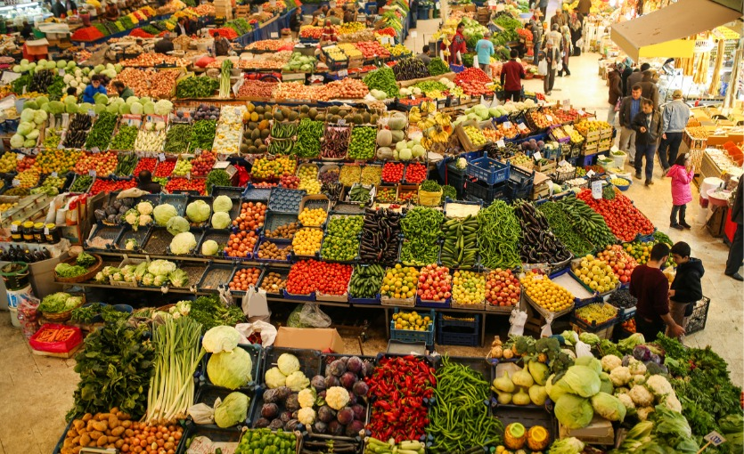
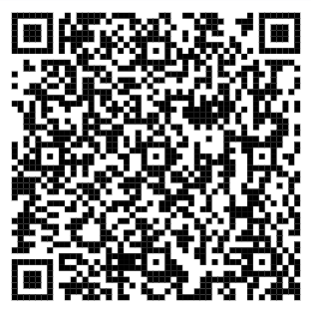
NEIGHBORHOOD MARKETS
ALANYA SEMT PAZARLARI
ALANYA NEIGHBORHOOD MARKETS The neighborhood market closest to our hotel is the Tuesday market. You can get detailed information about other neighborhood markets set up in Alanya by scanning the QR code.

Slide 18
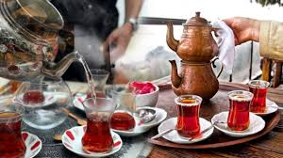
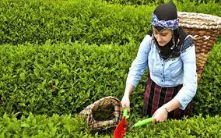
CULTURAL INFORMATION
TURKISH TEA
A type of black tea is produced in Türkiye and grows on the Eastern Black Sea coasts. This type of tea is commonly called Turkish tea. It is brewed with roasted black tea powder and served in its unique small glasses known as "ince belli" (slim-waisted).

Slide 19

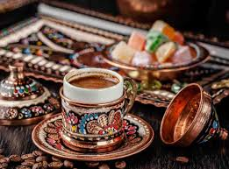
TURKISH COFFEE
Turkish coffee is one of the oldest coffee preparation and cooking methods that has come down to the present day from the Ottoman Empire, holding an important place in Turkish culture. It has a unique identity and tradition with its specific taste, foam, aroma, and serving style. It is the only type of coffee served with its grounds. Turkish coffee culture and tradition were inscribed on the UNESCO Representative List of the Intangible Cultural Heritage of Humanity on behalf of our country as of 2013.

Slide 20
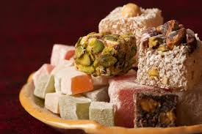
TURKISH DELIGHT
TURKISH DELIGHT Lokum (Turkish Delight) is a traditional Turkish dessert. Although it has been known in Anatolia since approximately the 15th century, it became widespread within the borders of the Ottoman Empire, especially in the 17th century. In Europe, it began to be known in the 18th century as "Turkish Delight" through an English traveler. Previously made with a mixture of honey or molasses and flour, the making and flavor of lokum changed in the 17th century thanks to the finding and introduction of refined sugar, known as "Kelle şekeri" (Head Sugar), and especially starch

Slide 21
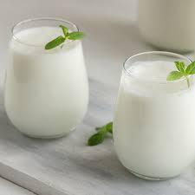
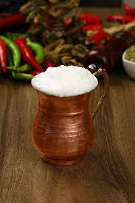
AYRAN
Ayran is a type of drink obtained by adding water to yogurt. It is one of the most common beverages belonging to Turkish cuisine. The Göktürks, who reigned between 552-745 AD, added water to sour yogurt to reduce its sourness. Thus, ayran emerged coincidentally. The word Ayran was first defined in history in the work Divan-ı Lügat-it Türk as "a drink obtained from milk".

Slide 22
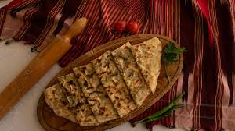
GÖZLEME
Gözleme is a type of Turkish flatbread snack prepared by filling thinly rolled dough (yufka) with various ingredients and then cooking it over a wood fire on a griddle (sac). "Közmen," meaning bread cooked on embers, was one of the first terms used for gözleme during the Seljuk period. Over time, due to the evolution of the spoken language and changing regional dialects, it changed and took the name gözleme.

Slide 23
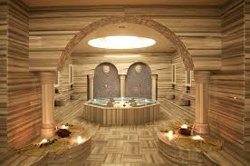
TURKISH BATH (HAMAM)
There has been a hamam culture in Anatolia since very old times. Turks brought their existing hamam traditions from Central Asia to Anatolia when they migrated. They overlaid their own traditions onto the marble bath culture left by those who lived before them. Over time, hamams became the places where very special days were celebrated. Today, "bridal hamam," "postpartum hamam," "baby's fortieth-day hamam," "vow hamam," and "mourning hamam" for women, and "groom's hamam," "circumcision hamam," "soldier's hamam," and "holiday hamam" for men, which still continue, maintain their currency.

Slide 24
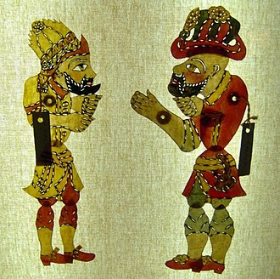
KARAGÖZ AND HACIVAT
Karagöz and Hacivat is a shadow play based on imitation and dialogue, performed on a screen with two-dimensional figures. The performer of Karagöz is called a puppeteer (kurgusal, hayali - the provided source text gives a literal translation error here, the correct term is hayali or hayalbaz, meaning 'fanciful' or 'shadow-master'). The change in dialogue in the play is done with head movements. It is not definitively known whether these two characters really lived, or where and how they lived if they did. The narratives are based on rumor, because even if they did live, they most likely were not considered important enough to enter history books during the mentioned period.

Slide 25
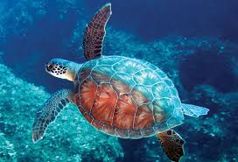
CULTURAL AND NATURAL HERITAGE - SEA TURTLE
Caretta carettas, which never come ashore except to lay eggs, are in the category of endangered species. Loggerhead sea turtles (Caretta caretta) and Green sea turtles (Chelonia mydas) lay eggs on the Mediterranean coasts of Türkiye. According to the results of studies conducted in the Mediterranean from past to present, Türkiye and Greece are the most important nesting areas for the Caretta caretta species.

Slide 26
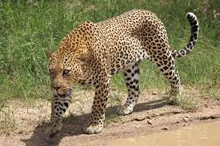
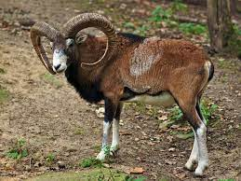
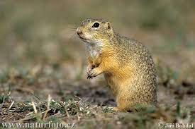
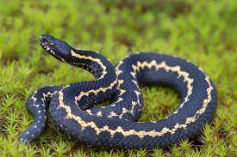
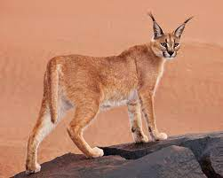
ENDEMIC ANIMAL SPECIES
SEA TURTLE
Caretta Caretta
ANATOLIAN LEOPARD
Pantera pardus tuttiana
ANATOLIAN MOUFLON Ovis orientalis anatolica
EUROPEAN GROUND SQUIRREL
Citellus citellus
HOPPA VIPER
Vipena kaznakovi
CARACAL
Felis caraca

Slide 27
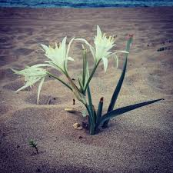
CULTURAL AND NATURAL HERITAGE SEA DAFFODIL (Pancratium maritimum)
The sea daffodil is a perennial, bulbous plant species belonging to the Amaryllidaceae family, which grows especially in the Mediterranean dunes. Its homeland is the Mediterranean region. It is an endemic plant species. Those who harm this plant in our country are subject to penal sanctions. Sea daffodils are generally seen in areas a few meters away from the sea. Its leaves, which resemble a long spear emerging from the base and can reach 40 cm in length, do not shed in winter. Its flowering time is between August and October.

Slide 28
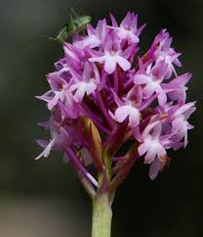
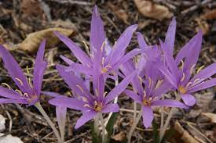
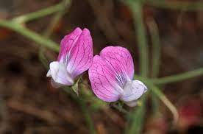
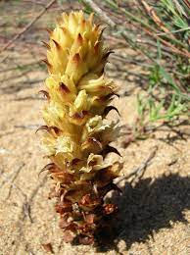
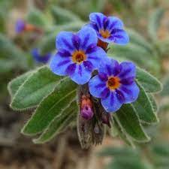
ENDEMİK BİTKİ TÜRLERİ
SEA DAFFODIL Pancratium maritimum
TAURUS ORCHID
Toglossum Montis-tauri
Macrophilla
Colchicum Baytopiorum
PHASELIS VETCH Lathyrus Phalitanus
S SIDE BROOMRAPE Orobanche Sideana
PERGE ALKANET Alkanra Macrophilla

Slide 29
POINTS TO CONSIDER WHEN VISITING LOCAL, HISTORICAL, ARCHAEOLOGICAL, CULTURAL, AND SPIRITUAL SITES
Please do not participate in tourist activities that involve animal exploitation.
Please be environmentally sensitive in travel areas.
In our country, the sale of cigarettes and alcoholic beverages to children under the age of 18 is prohibited.
Do not take photos of children or touch them without permission from their families.
Shoes are removed before entering sacred places like mosques, and women cover their hair with a scarf.

Slide 30
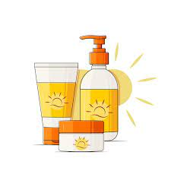
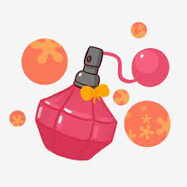


FOR OUR ENVIRONMENT;
Dear Guests, Choosing products that do not harm nature for your personal care products such as spray, deodorant, perfume, sunscreen, and insect repellent is the best investment for a sustainable environment. If a sunscreen contains any of the following ingredients, look for a marine life-safe alternative: Oxybenzone, Benzophenone-1, Benzophenone-8, OD-PABA, 4-Methylbenzylidene Camphor, 3-Benzylidene Camphor, nano-Titanium Dioxide, nano-Zinc Oxide, Octinoxate, Octocrylene.

Slide 31
WHAT CAN WE DO TO PROTECT OUR ENVIRONMENT?
Sort for recycling: Make a separate sorting for recyclable waste.
Glass instead of plastic: Glass is healthy and 100% recyclable.
Use fewer chemicals: Prefer fewer chemicals in household cleaning products.
Give ecological products a chance: Prefer ecological products as an alternative to single-use products. 5.
Prefer cloth bags for shopping: Cloth bags can be used repeatedly and washed. 6.
Walk more: Prefer walking for short distances to reduce vehicle use.
Protect water: Reduce your water consumption.

Slide 32
WHAT CAN WE DO TO PROTECT OUR ENVIRONMENT?
* CONSUME LESS ELECTRICITY: Turn off and unplug unnecessary running devices. * RESEARCH: Find out where or how a food you eat is produced. * CHANGE YOUR HABITS: Use a cloth bag instead of a plastic bag. * BE AWARE: Put out a bowl of water for stray animals. * CONSUME LESS WATER: Do not leave the water running continuously while brushing your teeth and washing your hands. * OBSERVE: Identify single-use items and use them less. * RENOVATE: Try to repair broken or damaged items before buying new ones. * DO NOT USE: Do not use single-use plastic straws. * RESPECT NATURE: Use less paper, use both sides of the paper. * RECYCLE: Dispose of your waste in appropriate recycling bins. * PLANT A SAPLING: Sprout a tree seed and plant the grown sapling in the soil. * SHARE: Share clothes you do not use with others.

Slide 33
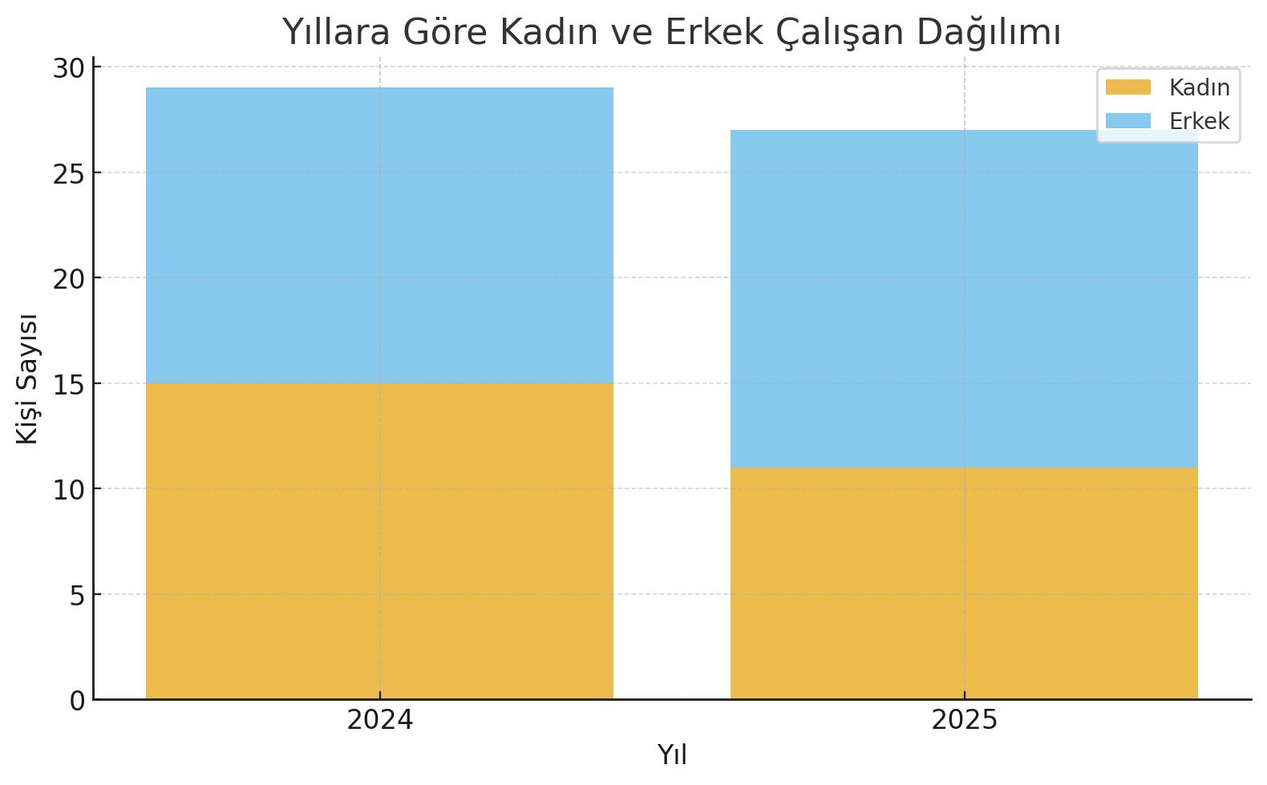
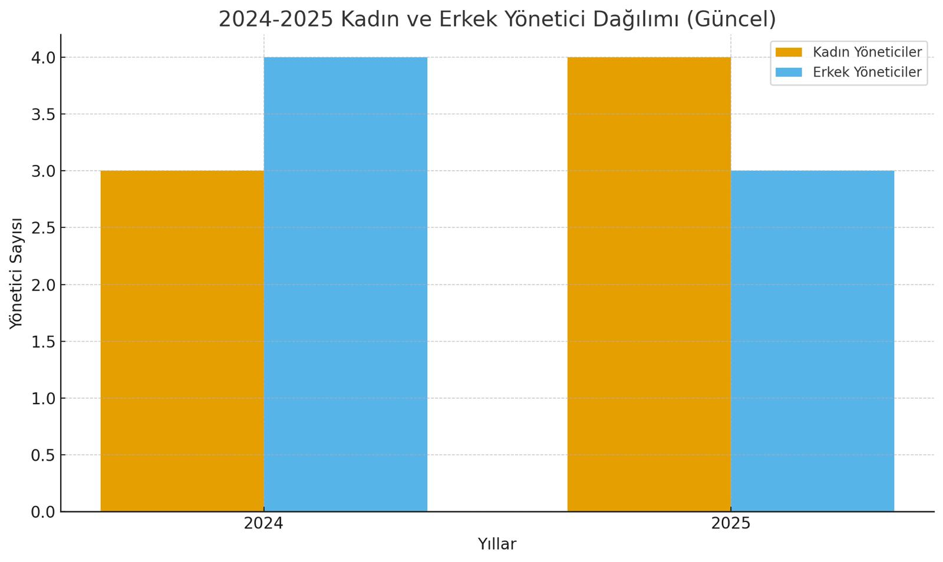
HUMAN RESOURCES
Female and Male Employee Distribution by Year Our current female employee ratio is 40.7%. We value the increased participation of women in the tourism sector. Our Goal: To increase the female employee ratio to 35%-40% in the 2026 season.
Female and Male Manager Distribution 2024-2025 (Current) The ratio of women in the management staff in 2024 was 43%. Our Goal: Our female manager ratio has increased to 57% in 2025. Our efforts to support female leadership and ensure equal representation continue. Our Goal: To maintain our female manager ratio at 50% in the 2026 season

Slide 34
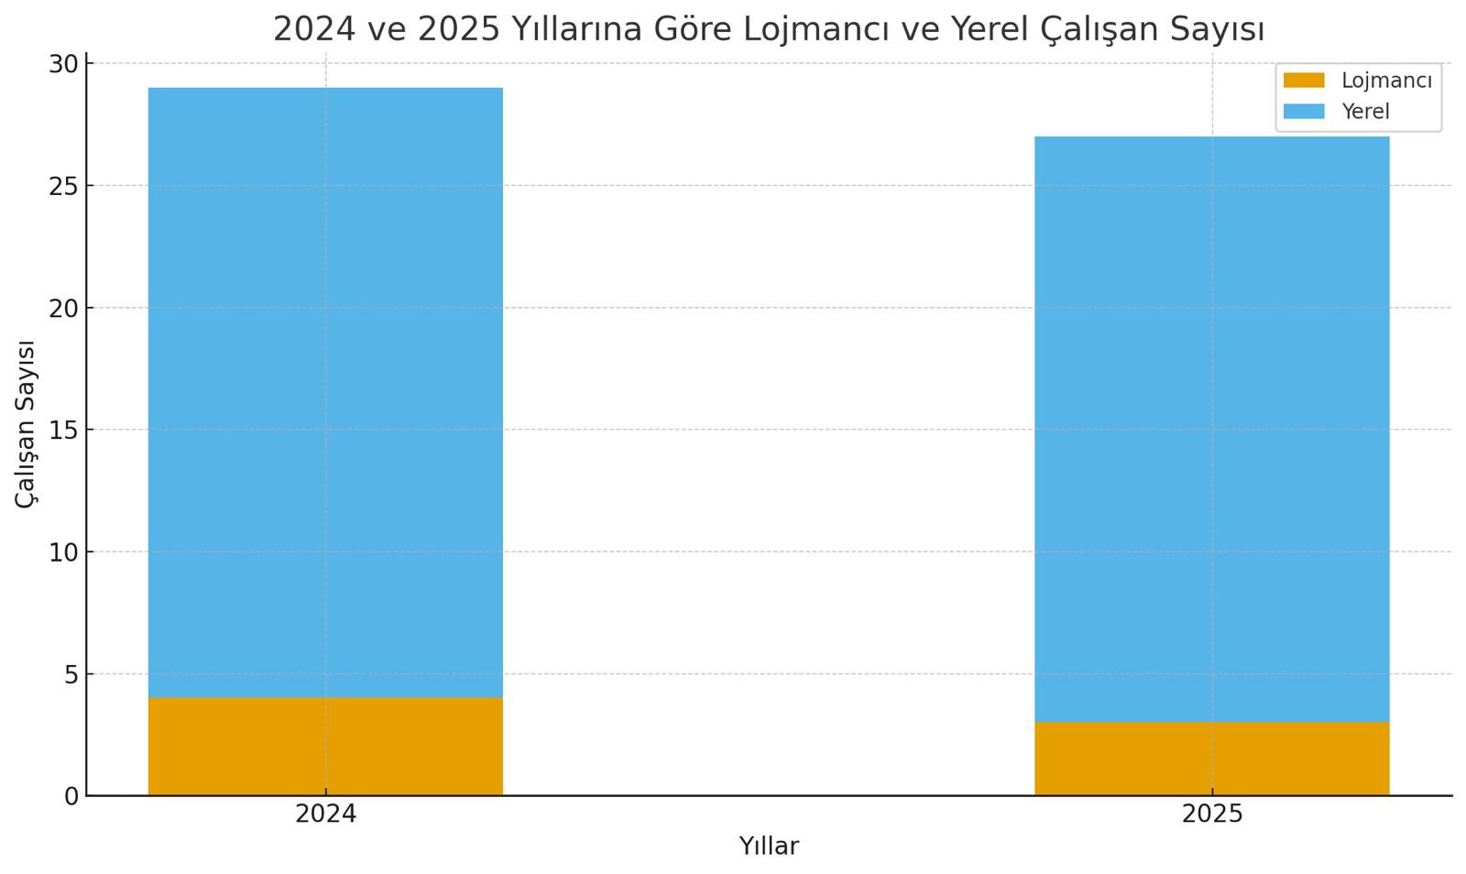
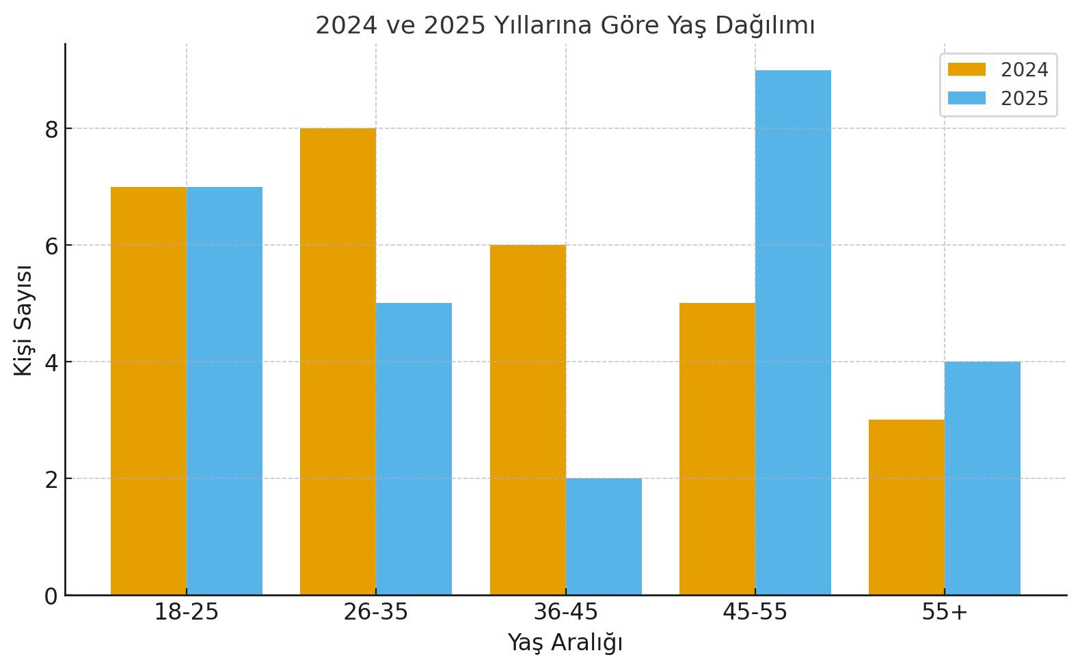
HUMAN RESOURCES
Comparison of Dormitory and Local Employee Numbers in 2024 and 2025 The local staff ratio was 86.2% in 2024, and this ratio increased to 88.9% in 2025. This is an indicator of the importance we attach to regional development and sustainable employment.
Our Goal: To increase the local staff ratio to 90% in the 2026 season. Age Distribution in 2024 and 2025 In 2025, 26% of our staff is in the 18-25 age range, which means we have a young and dynamic workforce structure. We also aim to create a healthy working environment where experience and dynamism are balanced with our experienced employees in the 26-45 age range.

Slide 35



OPPORTUNITIES OFFERED TO PERSONNEL
Accommodation (Dormitory) Opportunity:
Accommodation is provided for our personnel. The dormitories have facilities to meet personal needs.
Health Service Opportunity:
Our employees can receive health services from the doctor's office in our hotel during working hours. .
Meal Opportunity:
Meals are provided for our personnel at the staff dining hall for all meals.

Slide 36



ENERGY SAVING
We prefer high energy efficiency, local, and environmentally friendly devices and technologies. Our goal is to increase this ratio. Motion-sensitive sensors are used in general areas and staff areas. General areas are designed to benefit from daylight for energy saving.

Slide 37

ENERGY SAVING
Our exterior lighting and some cooling systems are controlled by timers. LED televisions are used in general areas and in our rooms. Mini-bars are positioned away from heat sources to save energy. Periodic maintenance and cleaning of all electronic devices are carried out to minimize energy losses.

Slide 38

ENERGY SAVING
We have solar panels to benefit from solar energy. We achieve 45% energy savings in the water heating system. Energy losses are prevented by checking the gaskets of cold rooms, deep freezers, ice machines, and refrigerated cabinets and replacing those that are worn out. Dishwashers, washing machines, and dryers are not operated without being fully loaded. All our energy consumptions are recorded and monitored on a monthly and yearly basis. Our personnel are trained on savings measures, and our guests are informed about our saving practices.

Slide 39
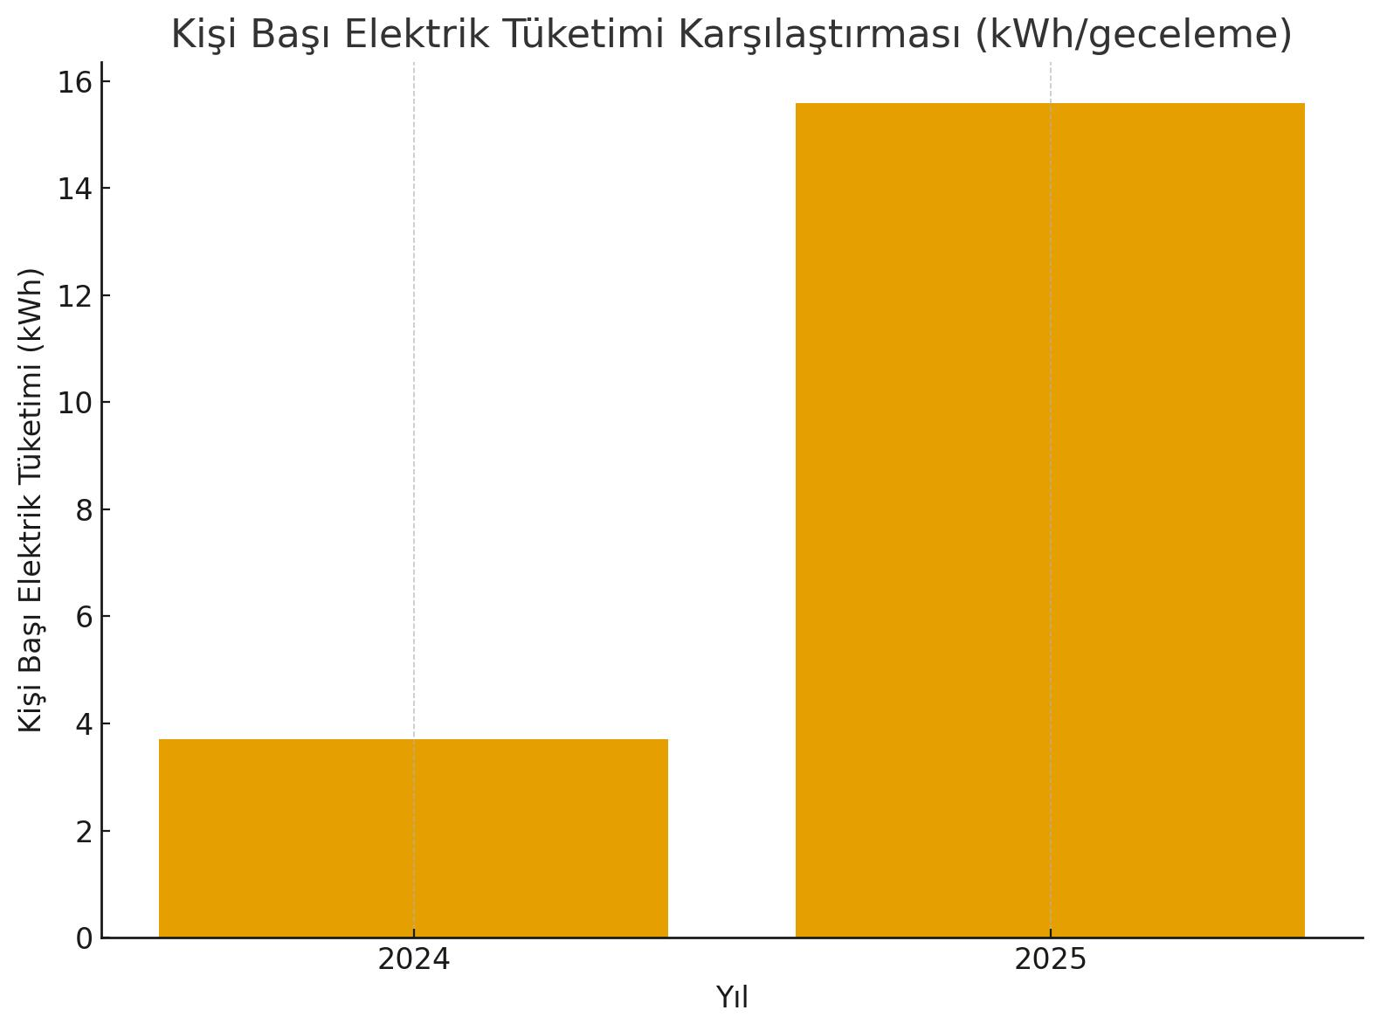

ENERGY SAVING
While total electricity consumption was 69,363.84 kWh in 2024, it decreased by 0.42% to 69,070.32 kWh in 2025. However, this situation increased the per capita electricity consumption from 3.70 kWh in 2024 to 15.58 kWh per overnight stay in 2025.
Our goal for 2026 is to reduce per capita electricity consumption to the range of 4-6 kWh per overnight stay

Slide 40
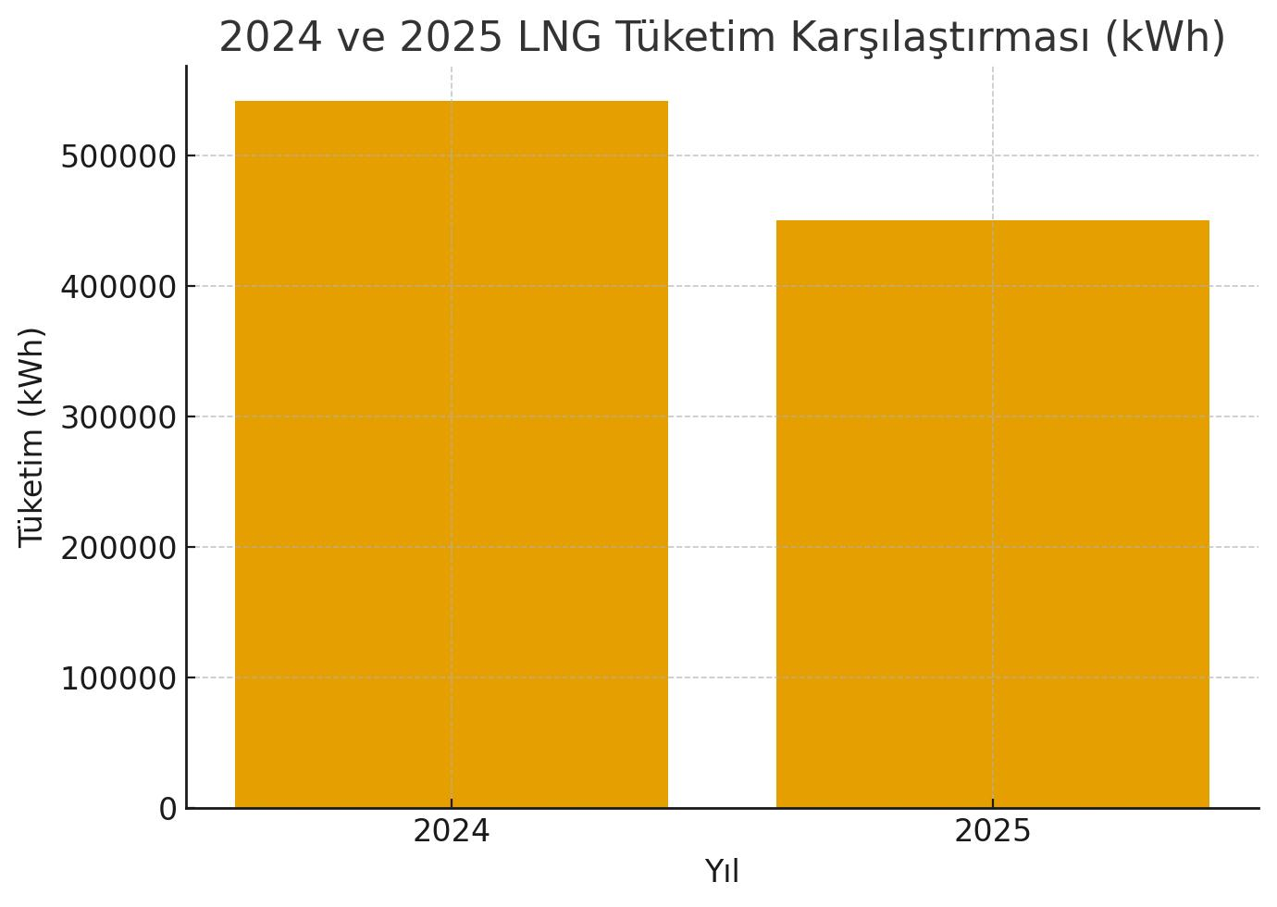
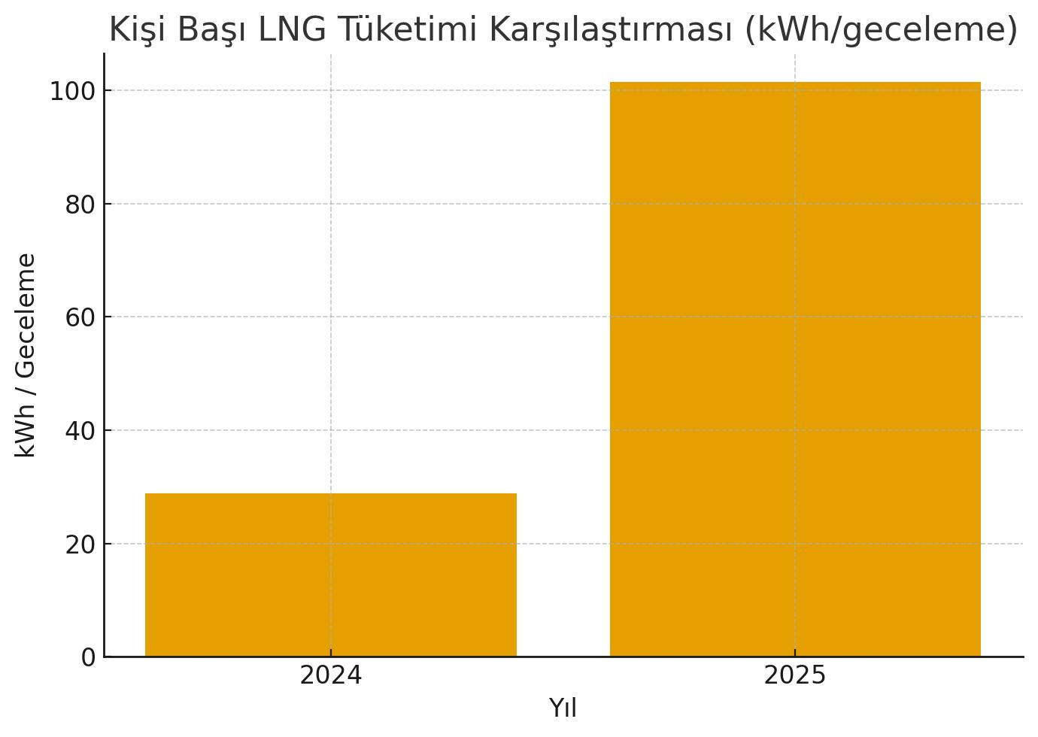
LNG USE LNG consumption was 541,765.24 kWh in 2024 and 449,948.80 kWh in 2025, showing a 17% decrease. This is a positive development for energy efficiency, but per capita consumption has increased due to the significant decrease in the number of overnight stays, resulting in a decrease in energy efficiency. Our goal is to reduce per capita LNG consumption to below 60 kWh per overnight stay in the 2026 season.

Slide 41
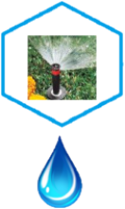


WATER SAVING
All rooms and general areas have aerators that save water. Economical dual flush systems (6 and 3 liters) are used in all toilets. Water losses are prevented by using drip and sprinkler systems for irrigation in our garden.

Slide 42


WATER SAVING
Our employees are trained on water saving. Our guests are informed about our saving practices. Wastewater is connected to the sewage system in compliance with the discharge regulation. Photocell taps and sensor urinals are used in all general areas. Our goal is to use photocell taps in all areas. Our water consumption is monitored and recorded on a monthly and yearly basis..

Slide 43

WATER SAVING
* Total water consumption in 2024 was very high. 2025 showed a decrease in both overnight stays and water consumption. The decrease in water consumption is at a higher rate than the decrease in overnight stays, which indicates an increase in per capita water use efficiency. * 2025 shows approximately 61% less total water consumption compared to 2024 (5982 \text{ m}^3 \rightarrow 2313 \text{ m}^3). * This reduction demonstrates the hotel's success in water saving and efficient water use practices. * Our goal for 2026 is to reduce total water consumption by 10%.

Slide 44

Comparison of Water Consumption in 2024 and 2025 (m³)

Slide 45






WASTE MANAGEMENT
We separate our waste at the source. We conserve our resources by mostly using reusable materials instead of single-use materials. We reduce paper consumption by conducting our correspondence via email and using both sides of the paper. We encourage our guests and employees to participate in recycling programs. We reduce packaging waste by purchasing large-packaged and concentrated products.

Slide 46

WASTE MANAGEMENT - NON-HAZARDOUS WASTE
Comparison of Non-Hazardous Waste Amounts 2024 – 2025
The total amount of waste decreased by 20% in 2025

Slide 47
HAZARDOUS WASTE
Hazardous waste is regularly collected in the Hazardous Waste Depot and delivered to a Licensed Waste Transport Company. In 2025, a total of 347 Kg of hazardous waste was disposed of mid-season.
Legend Items:
Hazardous 150110)
packaging (150110)
Liquid and solidoils (200126)
Atık boya ve vernikler (80111)
Waste paints and varnishes (80111)
Fluorescent lamps (200121)
Harmful silicone waste (70216)
Electrical equipment (200135)

Slide 48
OUR TRAININGS
Some of the trainings we conduct with our personnel are:
* SUSTAINABILITY / ENVIRONMENTAL TRAINING * HYGIENE TRAINING * OCCUPATIONAL SAFETY and HEALTH TRAINING * FIRE TRAINING and FIRE DRILL * CHEMICAL USE TRAINING * WORKING AT HEIGHT TRAINING * FIRST AID TRAINING * FOOD SAFETY TRAININGS * ZERO WASTE and WASTE MANAGEMENT TRAINING * ORIENTATION TRAINING

Slide 49




OUR ACTIVITIES
Beach cleaning event on June 5th, Environment Week.

Slide 50

SECTOR-STUDENT MEETING
We participated in the 2nd Sector-Student Meeting organized by Alanya Alaaddin Keykubat University on 16.04.2025 by setting up a stand.

Slide 51


OUR SURPRISE BIRTHDAY CELEBRATIONS

Slide 52

THANK YOU

